Slide 1
Attitude and Orbital Determination and Control Subsystem
Emitter
Attitude determination
Attitude control
Orbit control
Pointing
Receiver
Attitude determination
Attitude control
Orbit control
Pointing

Slide 2
Emitter Satellite
afbeelding
I_{xx} = 2.407 kgm² I_{yy} = 5.582 kgm² I_{zz} = 6.542 kgm²

Slide 3
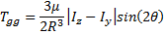
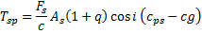
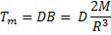
Disturbance Torques
Gravity gradient
Solar Radiation
Earth Magnetic Field
Aerodynamic Torques

Slide 4
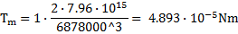
Disturbance Torques Emitter
Gravity gradient
Solar Radiation
Earth Magnetic Field
Aerodynamic Torques

Slide 5
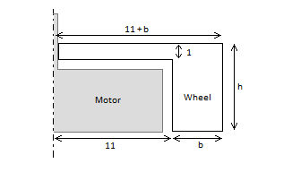
Reaction Wheels Emitter
Total disturbance torque 8.776·10⁻⁵ Nm
Safety margin of 2
Torque requirement 1.755·10⁻⁴ Nm
Angular acceleration 100 rad/s
h = 10 mm
b = 36 mm
m = 212 grams

Slide 6
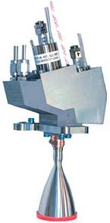
Thruster Emitter
ΔV requirement 225.38 m/s
Biproppelant thruster
I_{sp} = 291 s
Fuel mass 3.8 kg
Monomethylhydrazine 2.88 L
Dinitrogen Tetraoxide 1.32 L
Source: http://www.eads.com

Slide 7
Pointing Emitter

Slide 8
Receiver Satellite
I_{xx} = 1.307 kgm² I_{yy} = 0.101 kgm² I_{zz} = 1.316 kgm²

Slide 9
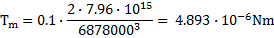
Disturbance Torques Receiver
Gravity gradient
Solar Radiation
Earth Magnetic Field
Aerodynamic Torques

Slide 10
Reaction Wheels Receiver
Total disturbance torque 1.65 ·10⁻⁵ Nm
Safety margin of 2
Torque requirement 3.31·10⁻⁵ Nm
Angular acceleration 100 rad/s
h = 10 mm
b = 11 mm
m = 36 grams

Slide 11
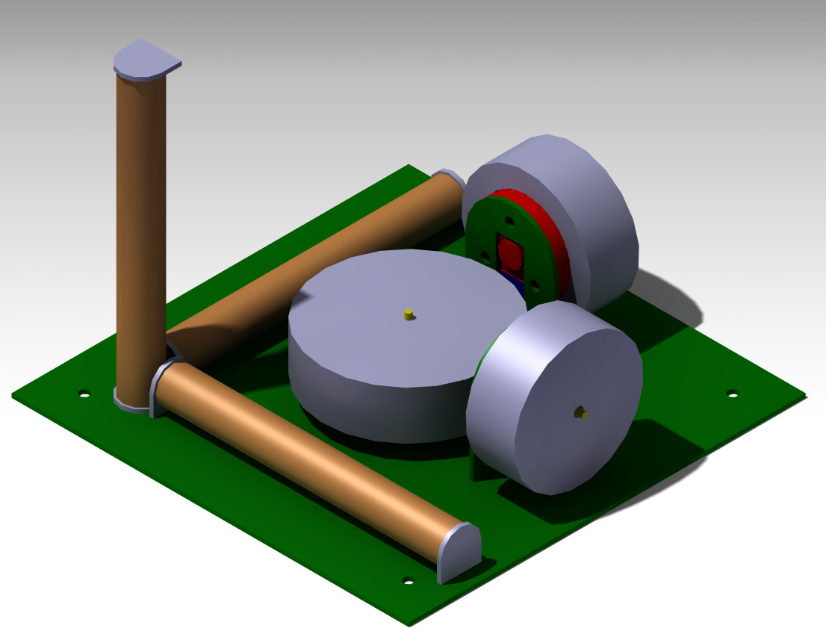
Attitude Control Receiver

Slide 12
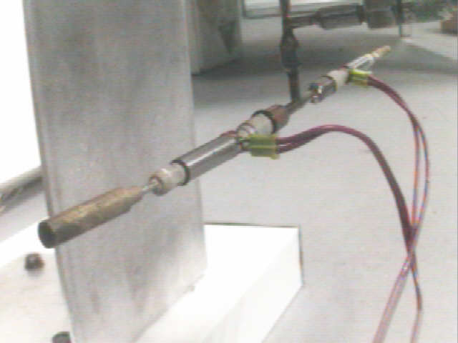
Thruster Receiver
ΔV requirement 165.14 m/s
Mono propellant thruster
I_{sp} = 120 s
Fuel mass 1.77 kg
Hydrogen Peroxide 1.23 L
Source: http://www.micro-a.net

Slide 13
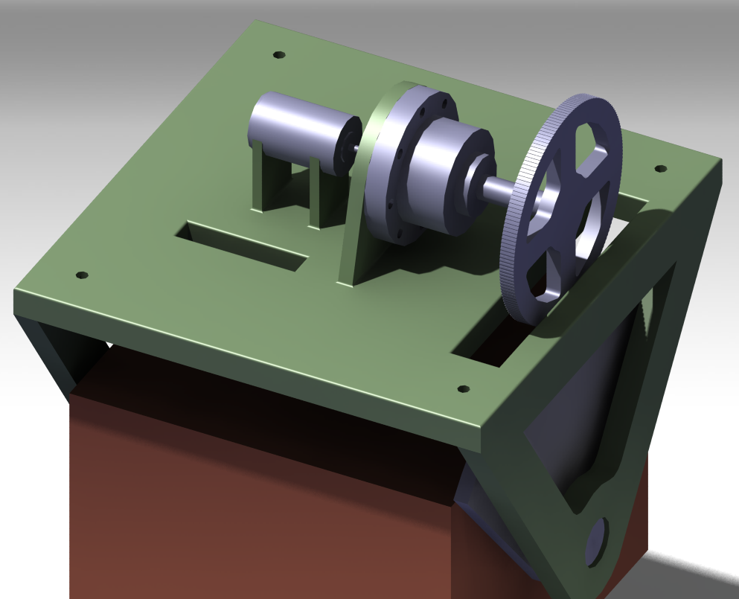
Pointing Receiver

